Slide 1
Howdy!
Welcome to CSCE 221 – Data Structures and Algorithms

Slide 2
Syllabus

Slide 3
Abstract Data Types (ADTs)
An abstract data type (ADT) is an abstraction of a data structure
An ADT specifies:
  Data stored
  Operations on the data
  Error conditions associated with operations
Example: ADT modeling a simple stock trading system
  The data stored are buy/sell orders
  The operations supported are
    order buy(stock, shares, price)
    order sell(stock, shares, price)
    void cancel(order)
  Error conditions:
    Buy/sell a nonexistent stock
    Cancel a nonexistent order

Slide 4
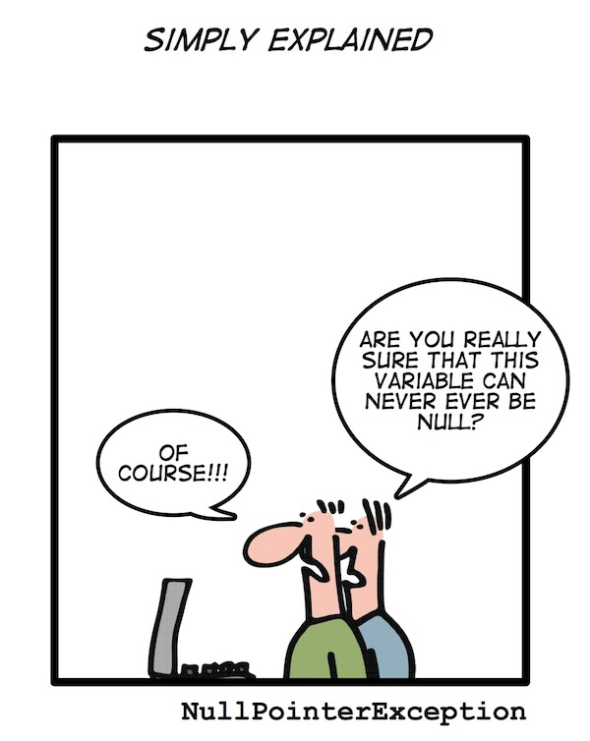
Exceptions
Attempting the execution of an operation of ADT may sometimes cause an error condition, called an exception
Exceptions are said to be “thrown” by an operation that cannot be executed

Slide 5
Ch5.
Stacks, Queues, and Deques
Acknowledgement: These slides are adapted from slides provided with Data Structures and Algorithms in C++, Goodrich, Tamassia and Mount (Wiley 2004) and slides from Nancy M. Amato

Slide 6
Stacks
The Stack ADT (Ch. 5.1.1)
Array-based implementation (Ch. 5.1.4)
Growable array-based stack

Slide 7
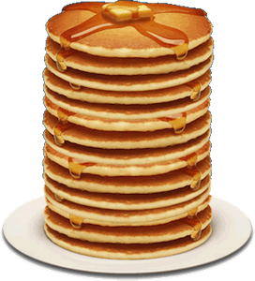
Stacks
A data structure similar to a neat stack of something, basically only access to top element is allowed – also reffered to as LIFO (last-in, first-out) storage
Direct applications
  Page-visited history in a Web browser
  Undo sequence in a text editor
  Saving local variables when one function calls another, and this one calls another, and so on.
Indirect applications
  Auxiliary data structure for algorithms
  Component of other data structures

Slide 8
The Stack ADT
The Stack ADT stores arbitrary objects
Insertions and deletions follow the last-in first-out (LIFO) scheme
Main stack operations:
  push(e): inserts element e at the top of the stack
  pop(): removes and returns the top element of the stack (last inserted element)
  top(): returns reference to the top element without removing it
Auxiliary stack operations:
  size(): returns the number of elements in the stack
  empty(): a Boolean value indicating whether the stack is empty
Attempting the execution of pop or top on an empty stack throws an EmptyStackException

Slide 9
Exercise: Stacks
Describe the output of the following series of stack operations
  Push(8)
  Push(3)
  Pop()
  Push(2)
  Push(5)
  Pop()
  Pop()
  Push(9)
  Push(1)

Slide 10
Run-time Stack
bar
PC = 1
m = 6
The C++ run-time system keeps track of the chain of active functions with a stack
When a function is called, the run-time system pushes on the stack a frame containing
  Local variables and return value
  Program counter, keeping track of the statement being executed
When a function returns, its frame is popped from the stack and control is passed to the method on top of the stack
main() {
int i;
i = 5;
foo(i);
}
foo(int j) {
int k;
k = j+1;
bar(k);
}
bar(int m) {
…
}
foo
PC = 3
j = 5
k = 6
main
PC = 2
i = 5

Slide 11

Array-based Stack
A simple way of implementing the Stack ADT uses an array
We add elements from left to right
A variable keeps track of the index of the top element
Algorithm $size()$
return $t+1$
Algorithm $pop()$
if $empty()$then
throw $EmptyStackException$
$$t←t −1$$
return $S\left[t+1\right]$
…
S
0
1
2
t

Slide 12

Array-based Stack (cont.)
The array storing the stack elements may become full
A push operation will then throw a FullStackException
  Limitation of the array-based implementation
  Not intrinsic to the Stack ADT
Algorithm $push(o)$
if $t=S.length−1$ then
throw $FullStackException$
$$t←t+1$$
$$S\left[t\right]←o$$
…
S
0
1
2
t

Slide 13

Note on Algorithm Analysis
Computer Scientists are concerned with describing how long an algorithm (computation) takes
  Described through functions which show how time grows
  as function of input, note that there are no constants!
  $O(1)$ – Constant time
  $O\left(\log{n}\right)$ - Logarithmic time
  $O(n)$ – Linear time
  $O(n^{2})$ – Quadratic time
More detain in CSCE 222, MATH 302, and/or later in
course

Slide 14

Performance and Limitations
- array-based implementation of stack ADT
Performance
  Let $n$ be the number of elements in the stack
  The space used is $O(n)$
  Each operation runs in time $O(1)$
Limitations
  The maximum size of the stack must be defined a priori, and cannot be changed
  Trying to push a new element into a full stack causes an implementation-specific exception

Slide 15


Growable Array-based Stack
In a push operation, when the array is full, instead of throwing an exception, we can replace the array with a larger one
How large should the new array be?
  incremental strategy: increase the size by a constant $c$
  doubling strategy: double the size
Algorithm $push(o)$
if $t=S.length−1$ then
$A←$ new array of size …
for $i←0$ to $t$ do
$A\left[i\right]←S[i]$
$S←A$
$$t←t+1$$
$$S\left[t\right]←o$$

Slide 16

Comparison of the Strategies
We compare the incremental strategy and the doubling strategy by analyzing the total time $T(n)$ needed to perform a series of $n$ push operations
We assume that we start with an empty stack represented
We call amortized time of a push operation the average time taken by a push over the series of operations, i.e., $T(n)/n$

Slide 17


Incremental Strategy Analysis
Let $c$ be the constant increase and $n$ be the number of push operations
We replace the array $k = n/c$times
The total time $T(n)$ of a series of $n$ push operations is proportional to
$$n + c + 2c + 3c + 4c + … + kc$$
$$=n + c\left(1 + 2 + 3 + … + k\right)$$
$$=n + c\frac{k(k+1)}{2}$$
$$=O\left(n+k^{2}\right)=O\left(n+\frac{n^{2}}{c}\right)=O\left(n^{2}\right)$$
$T(n)$ is $O(n2)$ so the amortized time of a push is $\frac{O\left(n^{2}\right)}{n}=O(n)$
Side note:
$$1+2+…+k \\ =\sum_{i=0}^{k}{i} \\ =\frac{k\left(k+1\right)}{2}$$

Slide 18

Doubling Strategy Analysis
We replace the array $k = log2 n$ times
The total time $T(n)$ of a series of n push operations is proportional to
$$n + 1 + 2 + 4 + 8 + …+ 2k$$
$$= n+2^{k+1}−1$$
$$=O\left(n+2^{k}\right)=O\left(n+2^{\log_{2}{n}}\right)=O\left(n\right)$$
$T(n)$ is $O\left(n\right)$ so the amortized time of a push is $\frac{O\left(n\right)}{n}=O(1)$
2
4
1
1
8

Slide 19
Singly Linked List
next
A singly linked list is a concrete data structure consisting of a sequence of nodes
Each node stores
  element
  link to the next node
elem
node
∅
A
B
C
D

Slide 20

Stack with a Singly Linked List
We can implement a stack with a singly linked list
The top element is stored at the first node of the list
The space used is $O(n)$ and each operation of the Stack ADT takes $O(1)$ time
nodes
top
∅
elements

Slide 21

Exercise
Describe how to implement a stack using a singly-linked list
  Stack operations: $push(x)$, $pop()$, $size()$, $isEmpty()$
  For each operation, give the running time

Slide 22
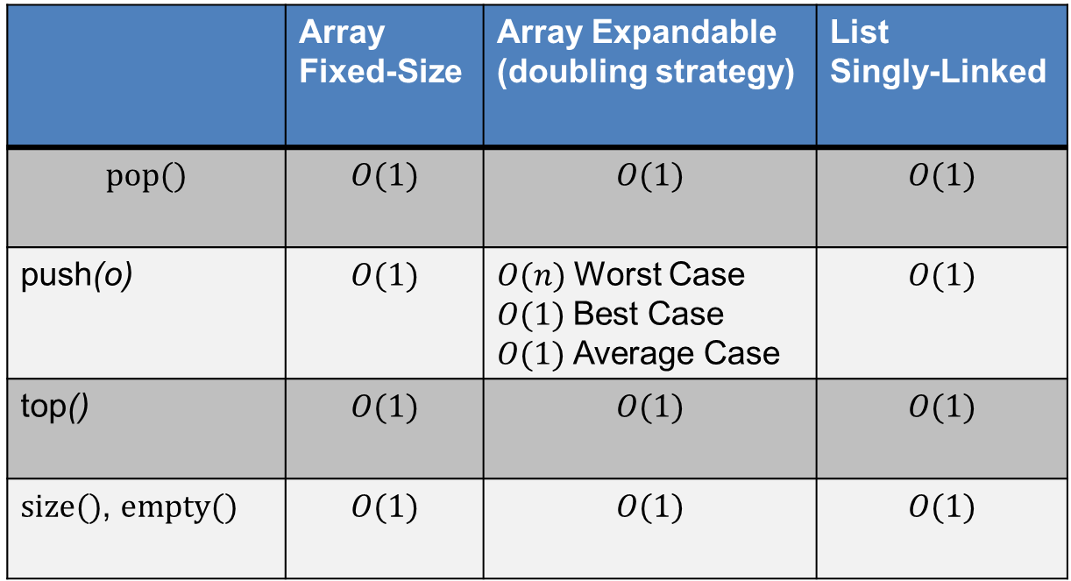
Stack Summary
 | Array Fixed-Size | Array Expandable (doubling strategy) | List Singly-Linked
$$pop()$$ | $$O(1)$$ | $$O(1)$$ | $$O(1)$$
push(o) | $$O(1)$$ | $O(n)$Worst Case $O(1)$Best Case $O(1)$Average Case | $$O(1)$$
top() | $$O(1)$$ | $$O(1)$$ | $$O(1)$$
$size()$, $empty()$ | $$O(1)$$ | $$O(1)$$ | $$O(1)$$

Slide 23
Queues
The Queue ADT (Ch. 5.2.1)
Implementation with a circular array (Ch. 5.2.4)
  Growable array-based queue
List-based queue

Slide 24
Applications of Queues
Direct applications
  Waiting lines
  Access to shared resources (e.g., printer)
  Multiprogramming
Indirect applications
  Auxiliary data structure for algorithms
  Component of other data structures

Slide 25

The Queue ADT
The Queue ADT stores arbitrary objects
Insertions and deletions follow the first-in first-out (FIFO) scheme
Insertions are at the rear of the queue and removals are at the front of the queue
Main queue operations:
  enqueue(e): inserts element $e$ at the end of the queue
  dequeue(): removes and returns the element at the front of the queue
Auxiliary queue operations:
  front(): returns the element at the front without removing it
  size(): returns the number of elements stored
  empty(): returns a Boolean value indicating whether no elements are stored
Exceptions
  Attempting the execution of dequeue or front on an empty queue throws an EmptyQueueException

Slide 26
Exercise: Queues
Describe the output of the following series of queue operations
  enqueue(8)
  enqueue(3)
  dequeue()
  enqueue(2)
  enqueue(5)
  dequeue()
  dequeue()
  enqueue(9)
  enqueue(1)

Slide 27

Array-based Queue
Use an array of size $N$ in a circular fashion
Two variables keep track of the front and rear
  $f$ index of the front element
  $r$ index immediately past the rear element
Array location $r$ is kept empty
normal configuration
Q
0
1
2
f
r
wrapped-around configuration
Q
0
1
2
r
f

Slide 28

Queue Operations
We use the modulo operator (remainder of division)
Algorithm $size()$
return $(N−f+r) mod N$
Algorithm $isEmpty()$
return $f=r$
Q
0
1
2
f
r
Q
0
1
2
r
f

Slide 29

Queue Operations (cont.)
Operation enqueue throws an exception if the array is full
This exception is implementation-dependent
Algorithm $enqueue(o)$
if $size()=N−1$then
throw $FullQueueException$
$$Q\left[r\right]←o$$
$$r←r+1 mod N$$
Q
0
1
2
f
r
Q
0
1
2
r
f

Slide 30

Queue Operations (cont.)
Operation dequeue throws an exception if the queue is empty
This exception is specified in the queue ADT
Algorithm $dequeue()$
if $empty()$then
throw $EmptyQueueException$
$$o←Q[f]$$
$$f←f+1 mod N$$
return $o$
Q
0
1
2
f
r
Q
0
1
2
r
f

Slide 31

Performance and Limitations
- array-based implementation of queue ADT
Performance
  Let $n$ be the number of elements in the stack
  The space used is $O(n)$
  Each operation runs in time $O(1)$
Limitations
  The maximum size of the stack must be defined a priori, and cannot be changed
  Trying to push a new element into a full stack causes an implementation-specific exception

Slide 32

Growable Array-based Queue
In $enqueue(e)$, when the array is full, instead of throwing an exception, we can replace the array with a larger one
Similar to what we did for an array-based stack
$enqueue\left(q\right)$ has amortized running time
  $O(n)$with the incremental strategy
  $O(1)$ with the doubling strategy

Slide 33

Exercise
Describe how to implement a queue using a singly-linked list
  Queue operations: $enqueue(x)$, $dequeue()$, $size()$, $empty()$
  For each operation, give the running time

Slide 34
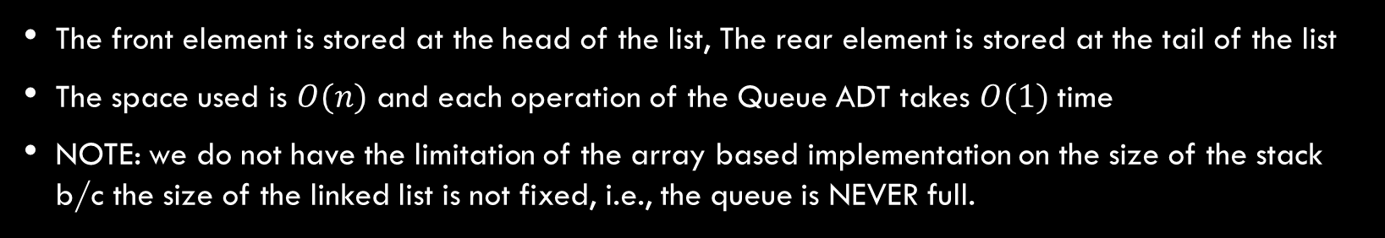
Queue with a Singly Linked List
The front element is stored at the head of the list, The rear element is stored at the tail of the list
The space used is $O(n)$ and each operation of the Queue ADT takes $O(1)$ time
NOTE: we do not have the limitation of the array based implementation on the size of the stack b/c the size of the linked list is not fixed, i.e., the queue is NEVER full.
r
nodes
front
f
∅
rear
elements

Slide 35
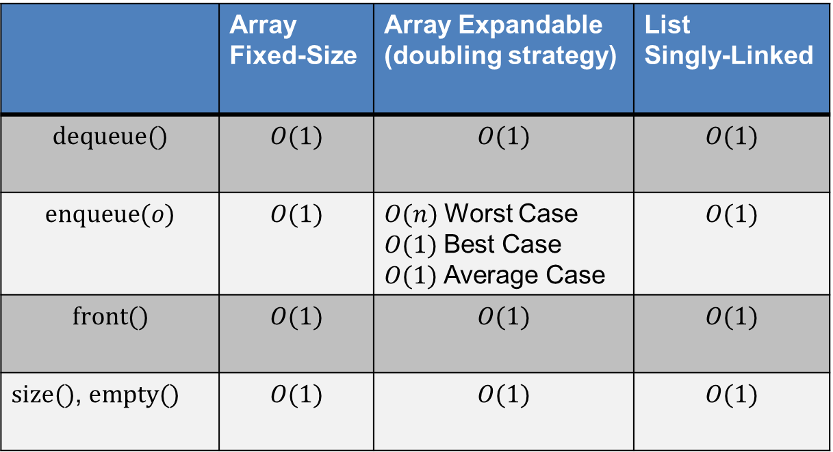
Queue Summary
 | Array Fixed-Size | Array Expandable (doubling strategy) | List Singly-Linked
$$dequeue()$$ | $$O(1)$$ | $$O(1)$$ | $$O(1)$$
$$enqueue(o)$$ | $$O(1)$$ | $O(n)$Worst Case $O(1)$Best Case $O(1)$Average Case | $$O(1)$$
$$front()$$ | $$O(1)$$ | $$O(1)$$ | $$O(1)$$
$size()$,$empty()$ | $$O(1)$$ | $$O(1)$$ | $$O(1)$$

Slide 36


The Double-Ended Queue ADT (Ch. 5.3)
The Double-Ended Queue, or Deque, ADT stores arbitrary objects. (Pronounced ‘deck’)
Richer than stack or queue ADTs. Supports insertions and deletions at both the front and the end.
Main deque operations:
  $insertFront(e)$: inserts element $e$ at the beginning of the deque
  $insertBack(e)$: inserts element $e$ at the end of the deque
  $eraseFront()$: removes and returns the element at the front of the queue
  $eraseBack()$: removes and returns the element at the end of the queue
Auxiliary queue operations:
  $front()$: returns the element at the front without removing it
  $back()$: returns the element at the front without removing it
  $size()$: returns the number of elements stored
  $empty()$: returns a Boolean value indicating whether no elements are stored
Exceptions
  Attempting the execution of dequeue or front on an empty queue throws an EmptyDequeException

Slide 37
Doubly Linked List
prev
next
A doubly linked list provides a natural
implementation of the Deque ADT
Nodes implement Position and store:
  element
  link to previous node
  link to next node
Special trailer and
header nodes
elem
node
header
nodes/positions
trailer
elements

Slide 38

Deque with a Doubly Linked List
The front element is stored at the first node
The rear element is stored at the last node
The space used is $O(n)$ and each operation of the Deque ADT takes $O(1)$ time
first
last
elements

Slide 39

Performance and Limitations
- doubly linked list implementation of deque ADT
Performance
  Let $n$ be the number of elements in the stack
  The space used is $O(n)$
  Each operation runs in time $O(1)$
Limitations
  NOTE: we do not have the limitation of the array based implementation on the size of the stack b/c the size of the linked list is not fixed, i.e., the deque is NEVER full.

Slide 40
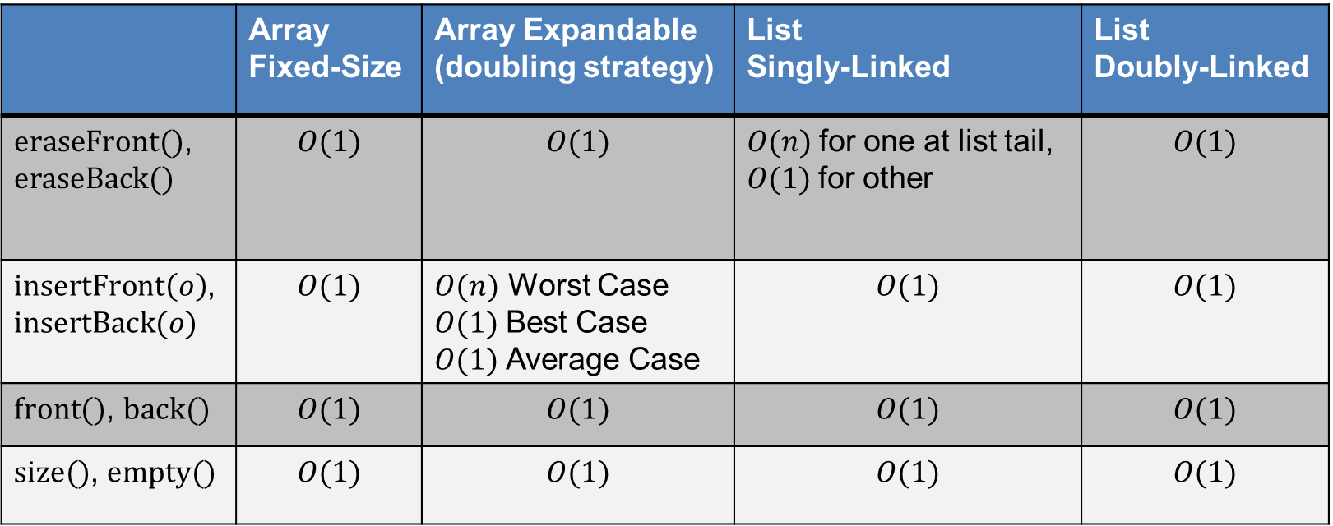
Deque Summary
 | Array Fixed-Size | Array Expandable (doubling strategy) | List Singly-Linked | List Doubly-Linked
$eraseFront()$, $$eraseBack()$$ | $$O(1)$$ | $$O(1)$$ | $O(n)$for one at list tail, $O(1)$for other | $$O(1)$$
$insertFront\left(o\right)$, $$insertBack(o)$$ | $$O(1)$$ | $O(n)$ Worst Case $O(1)$Best Case $O(1)$Average Case | $$O(1)$$ | $$O(1)$$
$front()$, $back()$ | $$O(1)$$ | $$O(1)$$ | $$O(1)$$ | $$O(1)$$
$size()$,$empty()$ | $$O(1)$$ | $$O(1)$$ | $$O(1)$$ | $$O(1)$$

Slide 41

Interview Question 1
How would you design a stack which, in addition to push and pop, also has a function min which returns the minimum element? push, pop and min should all operate in $O(1)$ time

Slide 42
Interview Question 2
In the classic problem of the Towers of Hanoi, you have 3 towers and N disks of different sizes which can slide onto any tower. The puzzle starts with disks sorted in ascending order of size from top to bottom (i.e. , each disk sits on top of an even larger one). You have the following constraints:
(1) Only one disk can be moved at a time.
(2) A disk is slid off the top of one tower onto the next tower.
(3) A disk can only be placed on top of a larger disk.
Write pseudocode to move the disks from the first tower to the last using stacks.

